Slide 1
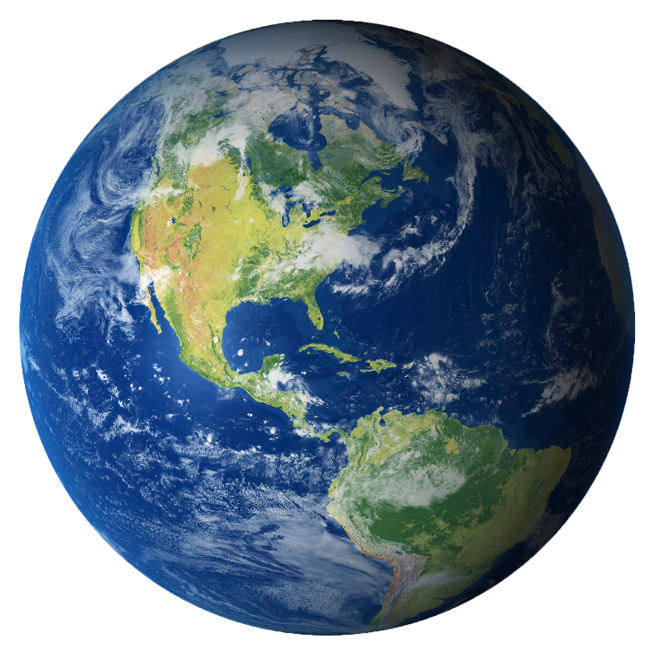
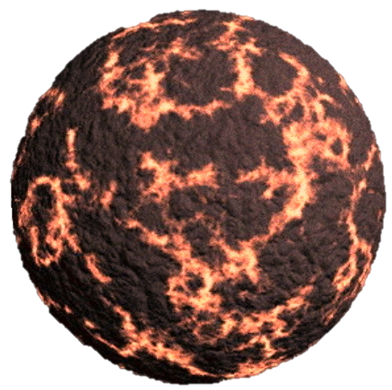
How Did Life Start on Earth?
Theories for Thought.

Slide 2
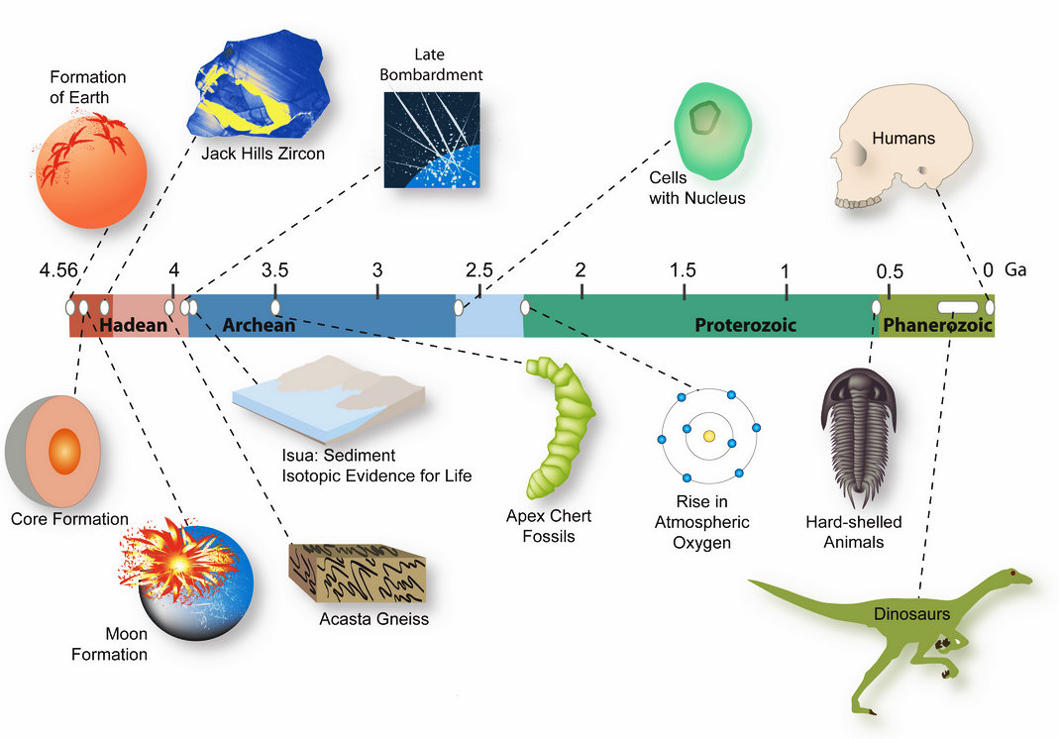
First Question: How Old is the Earth?
Creationist = between 4 and 10 thousand years old.
Science = “So far, oldest dated Earth rocks are 3.96 billion years”.
    http://abyss.uoregon.edu/~js/lectures/age_of_the_earth/age_of_the_earth.html
Estimates put the age of the Earth at about 4.6 billion years with an uncertainty of less than 1 percent.
  https://pubs.usgs.gov/gip/geotime/age.html
  Rough estimate due to the fact that Earth components are naturally recycled.
How old is the universe?
14 billion years old.

Slide 3
2 Main Pathways to Life = Abiogenesis
(With the necessary components available)
There are 2 pathways that may have introduced life on Earth
Earth
Earth
Random Chance: based upon existing laws of nature.
Seeding: Meteor brought life (or the ingredients( to Earth).
4 Billion Years Ago
Now

Slide 4
How Did Life Start:
Multiple Theories Abound
Spontaneous Generation: Pasteur debunked in 1850s
Intelligent Design:
  Creator:
Random events based upon existing physical laws
  Seeding = Meteors deposited the necessary basic components.
  Primordial Soup = life started naturally as a result of chemical evolution.
Single event or many, many times?

Slide 5
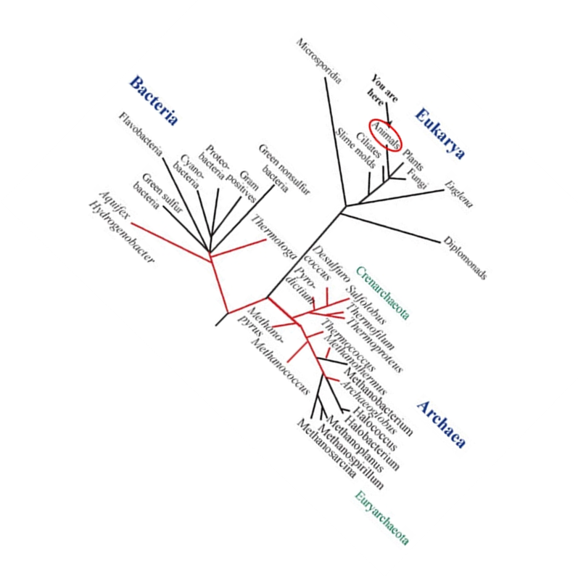
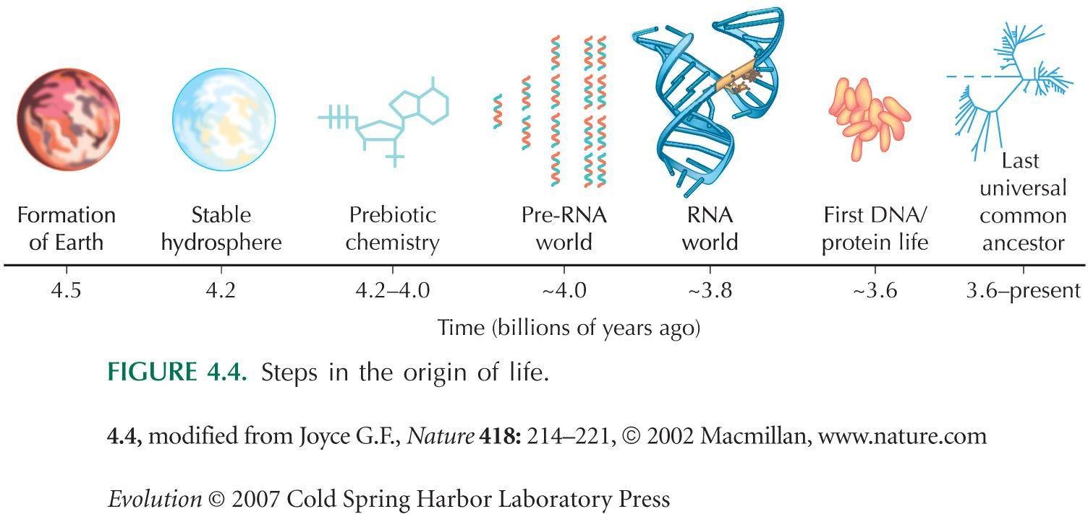
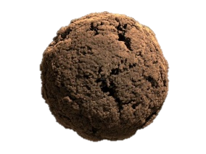
The Most Widely-Accepted Scientific Explanation
LUCA

Slide 6
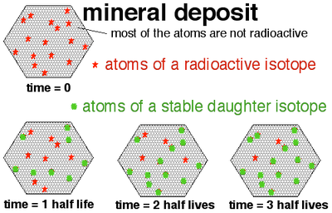
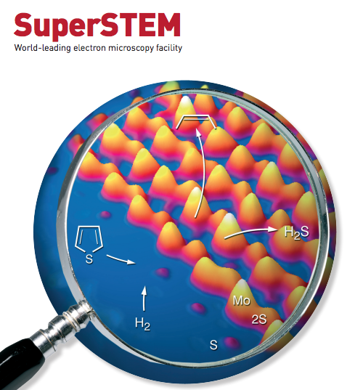
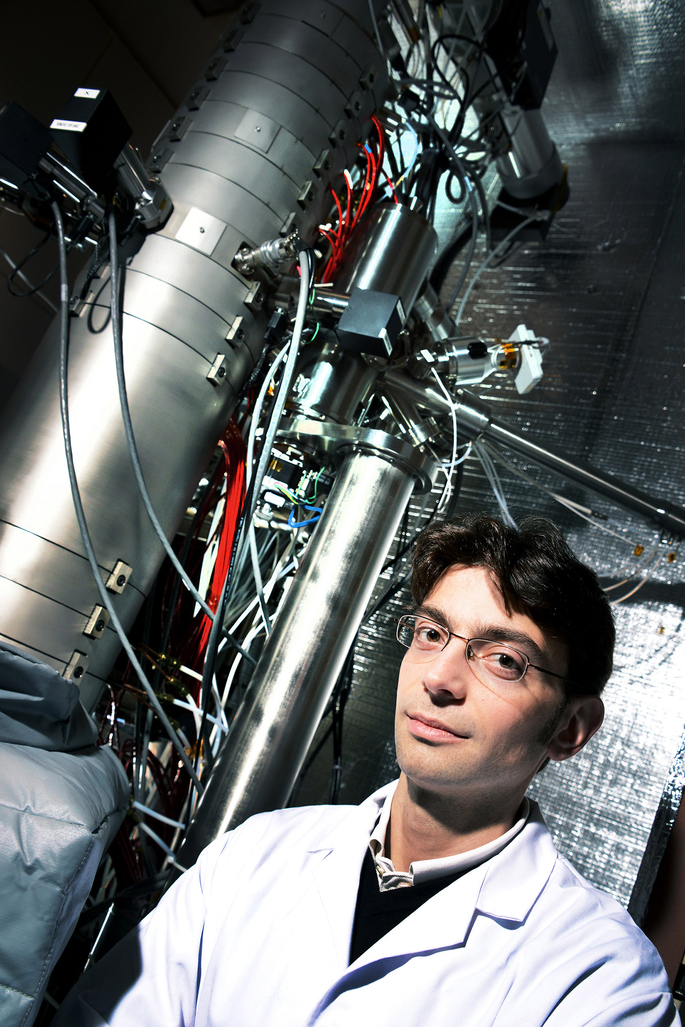
Evidence
What exists for us to use to support one theory or another?
Age of the Earth & Life = radio dating, high-resolution mass spectrometry, SuperSTEM microscope.
Life:
Creationism
  Religious text or mythology passed down… FAITH.
  We do not discuss this in detail in schools because of separation of church and state ☺
Seeding
  Craters & meteorites
Probability of a Random Event through chemical evolution.
  Oparin-Haldane Theory:
  Miller-Urey Experiment:
  Lerman Model:

Slide 7
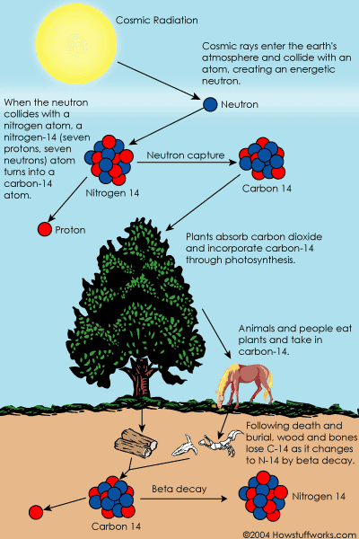
Carbon Dating: How we know how old stuff is on Earth.
Aging stuff on Earth is not a random act.
Carbon 12 & Nitrogen are stable.
Carbon 14 is a radioactive isotope that is formed from a neutron/proton swap with nitrogen 14 in the atmosphere.
It takes 5,700 years for half of the carbon 14 to decay back to nitrogen 14
By knowing that unstable radioactive isotopes take specific amounts of time to become stable we can determine how old rocks and fossils are.
+ Mass spectrometry allows us to identify the exact composition of elements in samples.

Slide 8
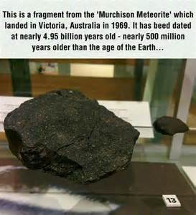
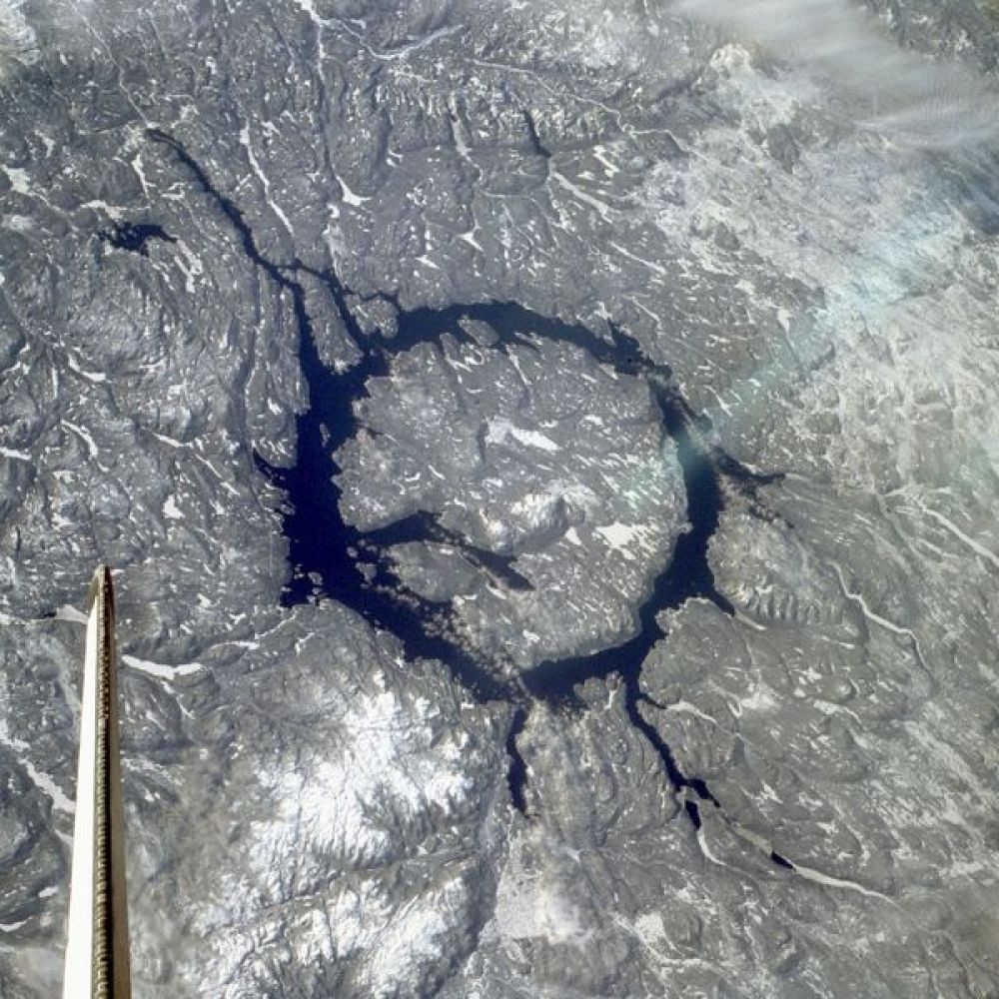
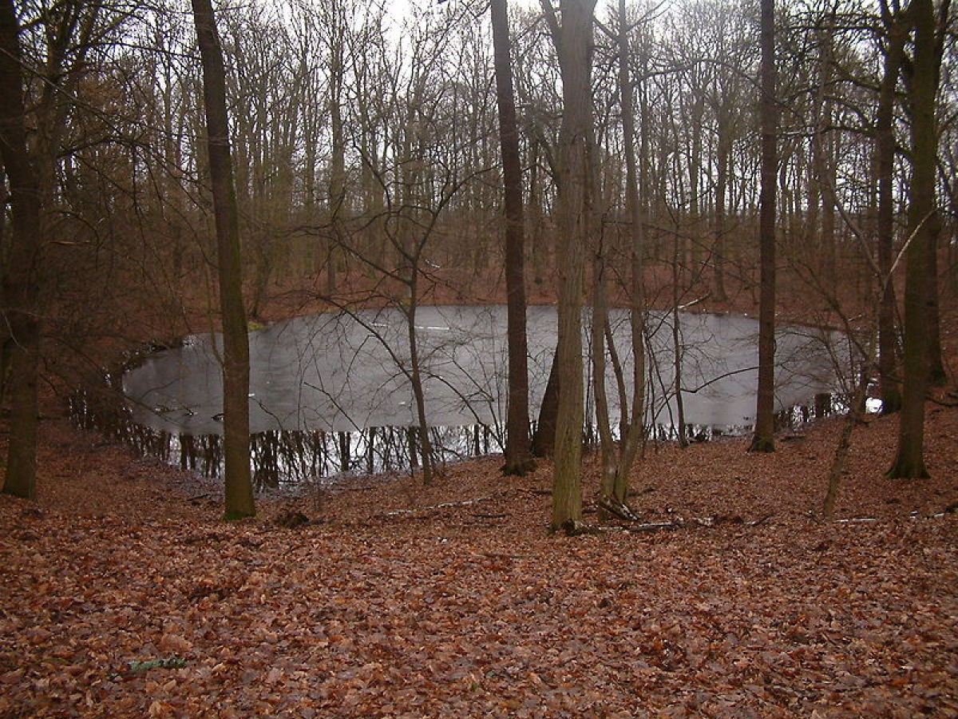
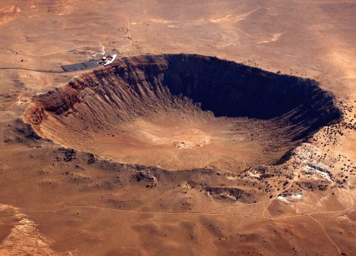
Meteors… the ‘Seeding’ theory.
No debate: Earth has been hit by multiple asteroids and meteors.
One of these could have carried life, DNA, RNA, amino acids or other organic compounds that got life started.
  “analysis of the Murchison meteorite, which fell to Earth more than 40 years ago, reveals tens of thousands of organic compounds” – scientificamerican.com

Slide 9
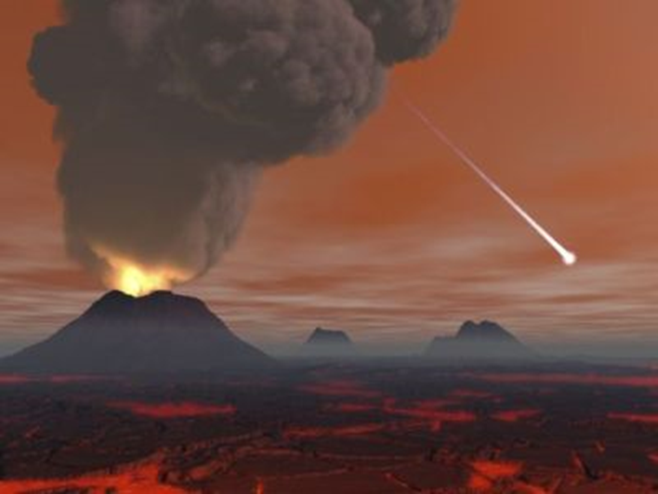
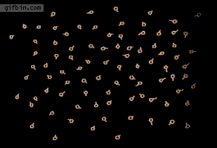
Oparin-Haldane Theory: 1929
Oparin & Heldane were 1st to (independently) theorize that organic molecules could have randomly formed in what is believed to be oxygen-free atmosphere present 4 billion years ago.
Basis of what is called the Primordial Soup theory.
  That early Earth’s atmosphere was made of:
    Ammonia,
    Water,
    Hydrogen sulfides
    Carbon Dioxide
    Phosphates
    No Oxygen!
The basic chemicals, RNA amino acids or others initiated a cascade of events that led to reproductive life.

Slide 10
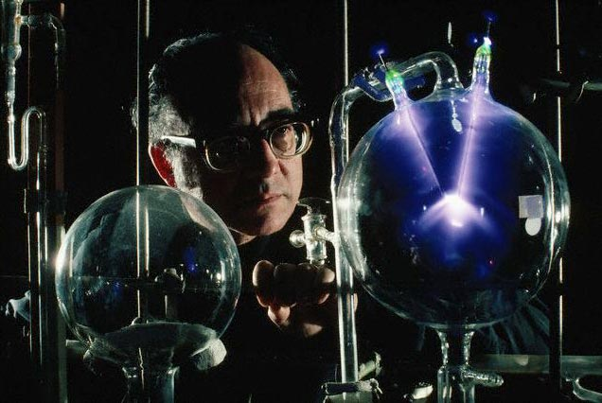
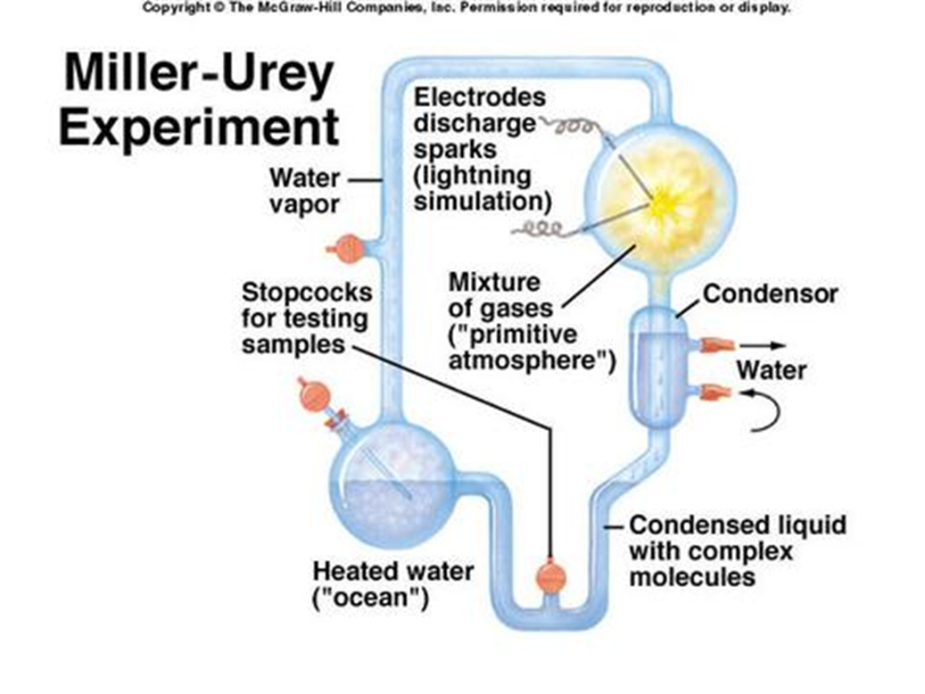
Miller-Urey Experiment: 1953
Testing of Oparin-Haldane theory.
Ingredients:
  water (H₂O),
  methane (CH₄),
  ammonia (NH₃),
  hydrogen (H₂)
Put these into a container meant to simulate Earth’s early atmosphere.
Add a spark (simulating a lightning strike)
What gets created?
Amino acids & other organic molecules!
This proves that given the proper circumstances, the basic compounds of life can spontaneously form!
Photo credit: Â© Corbis Images

Slide 11
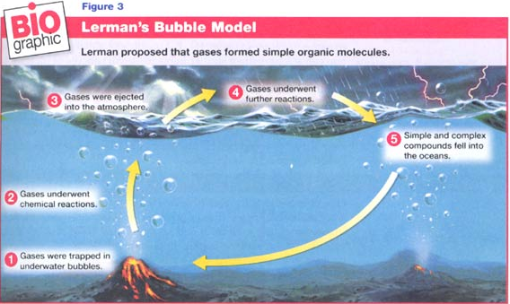
Lerman Bubble Model: 1986
Another plausible theory that supplements the Miller-Urey experiments.
Including data from thermo vents expelling toxic chemicals at the base of the ocean.

Slide 12
Summary: Write this down. (5min)
According to the evidence…
The Earth is estimated to be close to 4.6 billion years old.
Abiogenesis is the natural process of life arising from non-living matter, such as simple organic compounds.
Life is to believed to have started roughly 3.8 billion years ago.
The first life was likely a single-celled organism.
This “LUCA” (Last Universal Common Ancestor) became the basis for all other life to evolve from. (at least once) though recent data may suggest more than one possible abiogenesis event.
Although it can’t be confirmed now, it is also probable that basic constituents for life could have been planted from another planet on an asteroid (called seeding).
The other major alternative to abiogenesis is that it was a consequence of natural chemical evolution.
Evidence is found in carbon dating, which dates the age of rocks and fossils, and the organic compounds found in meteors.
Oparin-Haldane, Miller-Urey, Lerman models offer suggestions that help explain abiogenesis.
Complete the History of Life on Earth worksheet by next class. (20pts, HW)

Slide 13
Summary Concept Check
How old is the Earth?
How long does the physical evidence say life has existed on Earth?
What are some of the ‘scientific’ explanations to explain how life started? (there are 2 main ones).
Complete the History of Life on Earth worksheet by next class. (20pts, HW)

